Slide 1
13539 - Pac-Man

Slide 2
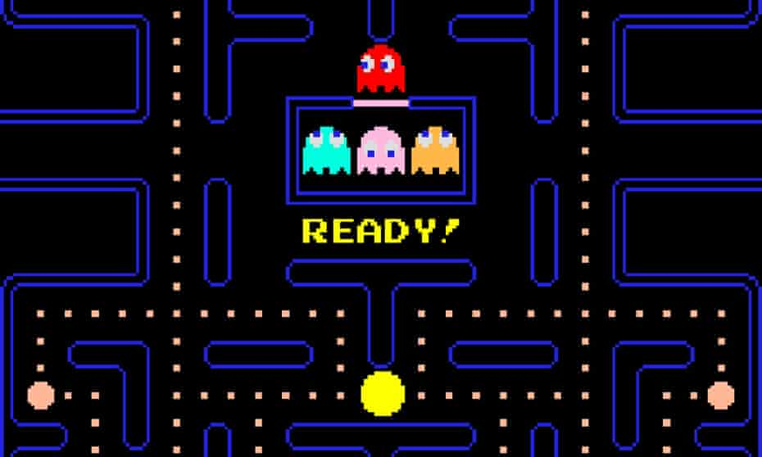
Description
Your goal is to find the minimum number of steps to eat all the dots inside an enclosed maze without ghosts.

Slide 3
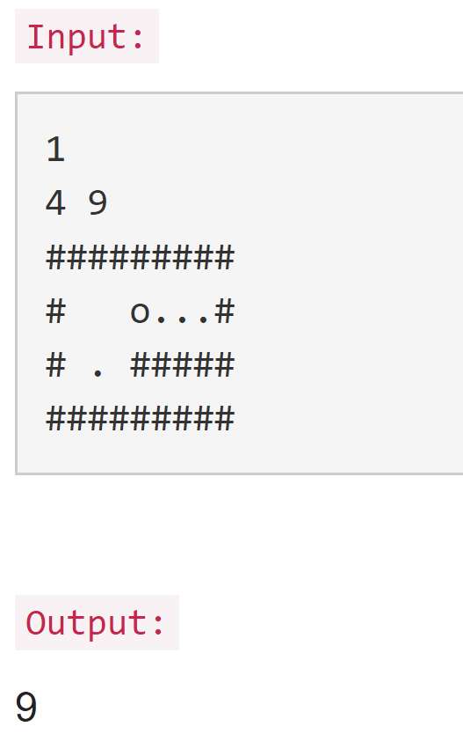
Input/Output
Possible tiles:
'o': The PacMan on a tile
' ': Nothing on a tile
'.': A dot on a tile
'#': Wall
All valid inputs. Guaranteed that:
​all tiles other than wall tiles are within an enclosed area formed by wall tiles;
no more than 5 dots;
there is at least one solution.
Sequence of steps: ASAWDDDDD
​W: move the PacMan up
A: move the PacMan left
S: move the PacMan down
D: move the PacMan right
# of test cases
test case

Slide 4
Another BSF: State Definition
struct state{
char Board[256][256];
int PacManX, PacManY;
int cntDot, cntStep;
state():cntDot{0},cntStep{0}{}
bool operator <(const state &r) const {
for(int i=0;i<n;i++)
for(int j=0;j<m;j++)
if(Board[i][j]!=r.Board[i][j])
return Board[i][j] < r.Board[i][j];
return 0;
}
};
Main data structures:
queue<state> Q;
set<state> S;//the set storing visited states
Q.push(start);
S.insert(start);
while(Q.size()){
state now = Q.front(); Q.pop();
for(int i=0;i<4;i++){//try 4 directions
state next = now;
…
//push to queue if never appeared
if(S.find(next)==S.end()){
Q.push(next);
S.insert(next);
}
}
}

Slide 5
This basic version can lead to MLE and/or TLE.
Can we do better?

Slide 6
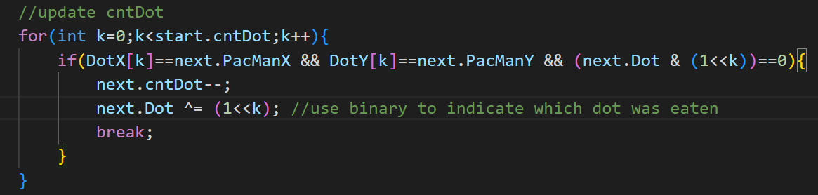
An Enhanced State Definition
char Board[256][256];
int DotX[5], DotY[5];
struct state{
int PacManX, PacManY;
int cntDot, cntStep;
int Dot; //Use binary to indicate which dot was eaten
state():cntDot{0},cntStep{0},Dot{0}{}
bool operator <(const state &r) const {
if(PacManX != r.PacManX)
return PacManX < r.PacManX;
if(PacManY != r.PacManY)
return PacManY < r.PacManY;
if(Dot != r.Dot) return Dot < r.Dot;
return 0;
}
};
What are the differences?
A single Board[256][256] array
int DotX[5], DotY[5];
To record the dot positions
In struct state
Use each bit of “int Dot;” to represent if each corresponding dot has been eaten or not.
bool operator <(const state &r) const;

